Slide 1
Sales insights
Team –
Abhishek, Anshika, Karthik, Nishchay, Vasudha, Vishnu.

Slide 2
Problem Statement
This project is about tracking various kind of information about sales of an online retailer, like:
Most Ordered Product.
Tracking the most Revenue Generated Product.
Highest Sales Generating States and Cities.
Month-wise sales and revenue generated.
Total Tax paid for each Month.

Slide 3

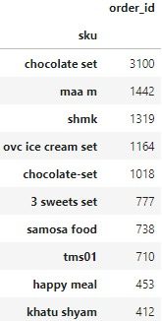
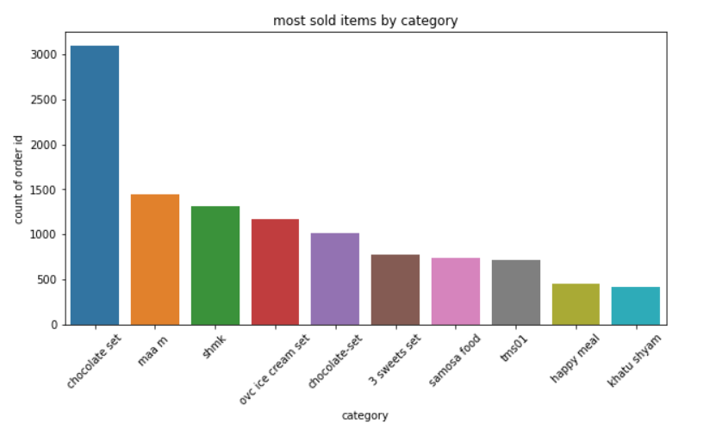
Most Ordered Items
Most sold Product was Chocolate Set with 3100 ordered pieces.

Slide 4

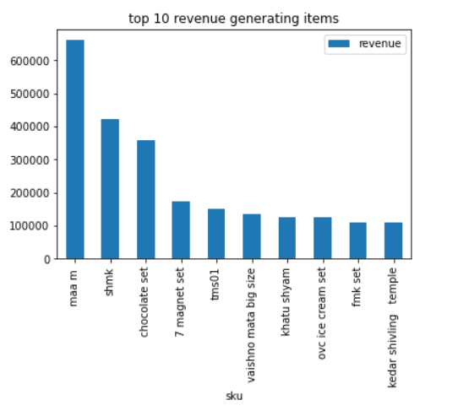
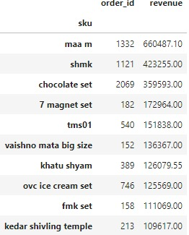
Most Revenue Generated
Maa m, generated highest revenue of Rs. 660487.

Slide 5

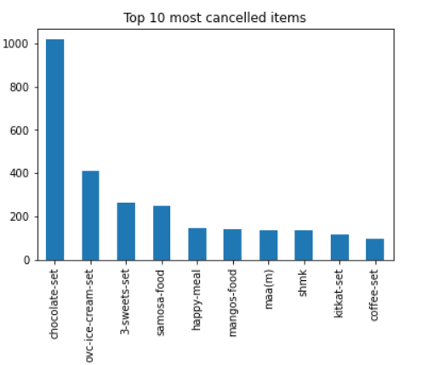
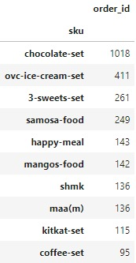
Most Cancelled Items
The most cancelled Item was Chocolate-set with 1018 cancelled orders.

Slide 6
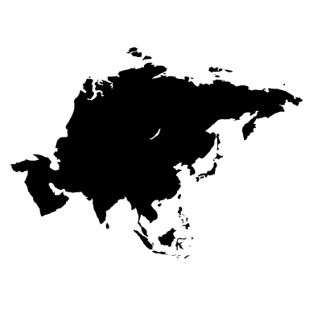
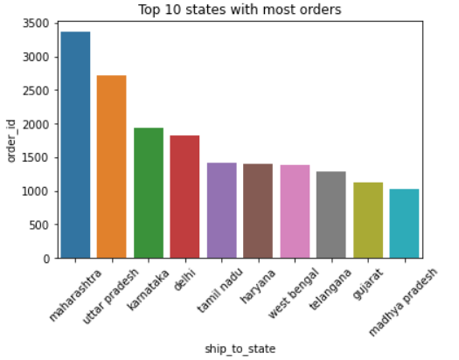
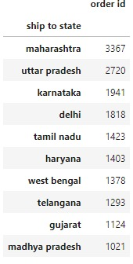
State-wise Sales
Maharashtra saw the highest sale of 3367.

Slide 7

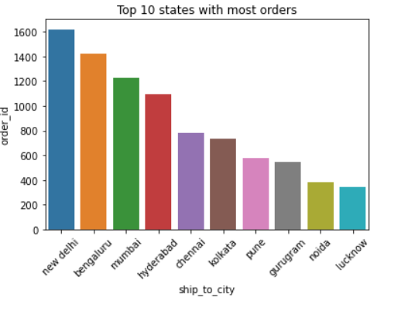
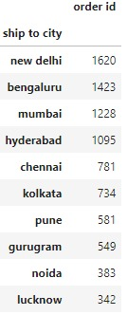
Top 10 Cities with highest sales
Highest sales generated from each city.
New Delhi has highest orders of 1620.
Bengaluru saw a sale of 1423.

Slide 8

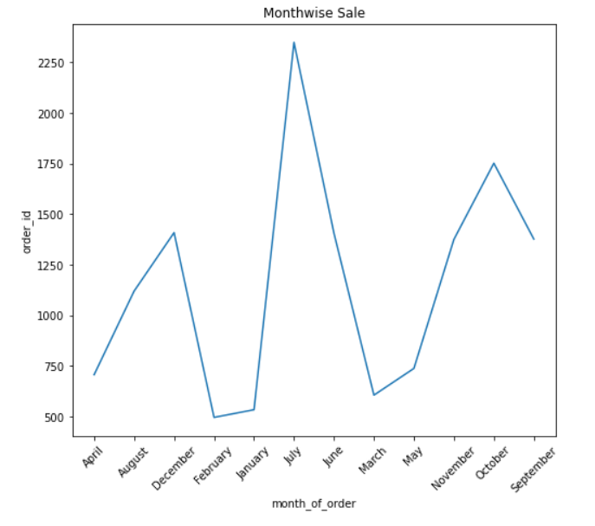
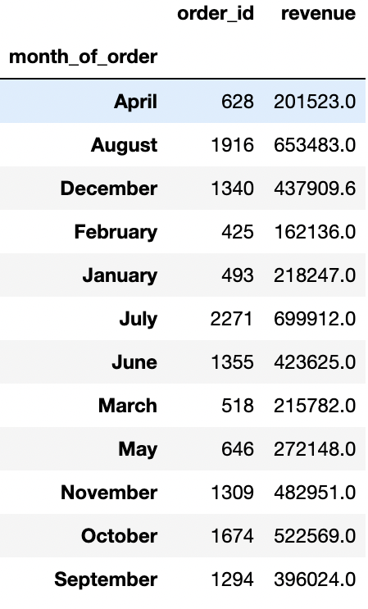
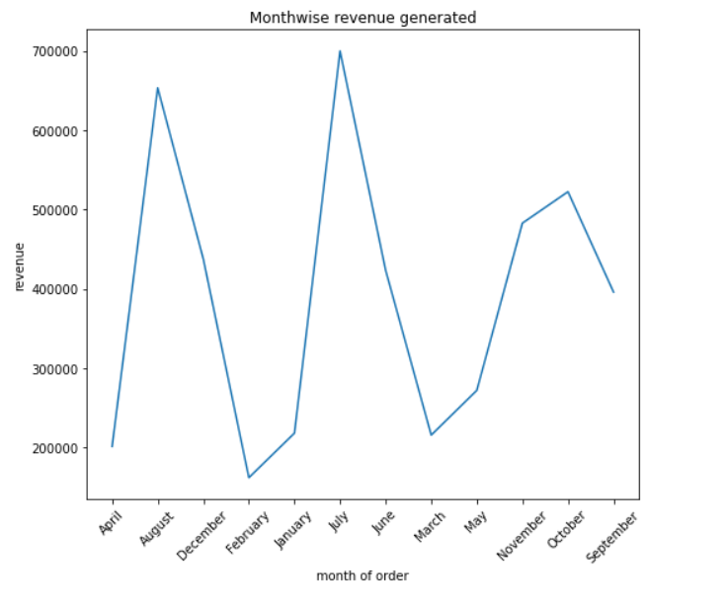
Monthly Sales & Revenue
July saw highest sales and revenue
of Rs.726336

Slide 9
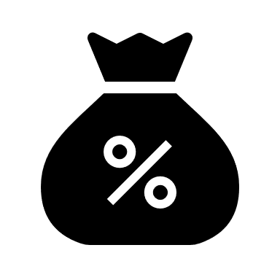
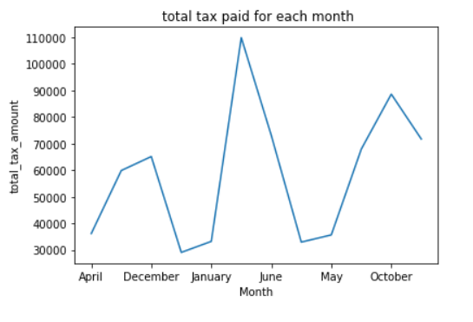
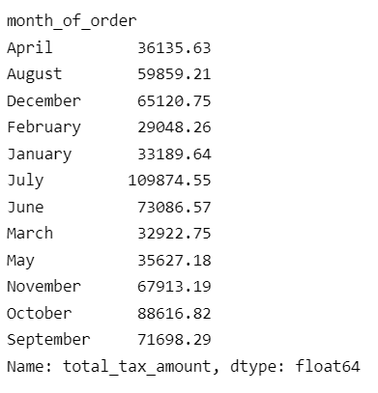
Monthly Tax
The Highest Tax paid in July ( Rs.109874).

Slide 10


Thank You

